Slide 1
Table of Contents
Substitution Ciphers
Caesar Cipher or Caesarian Shift
Atbash Cipher
Morse Code
Letter Numbers
ROT13
Baconian
Hill Cipher
Letter Frequency Attacks
The Enigma machine

Slide 2
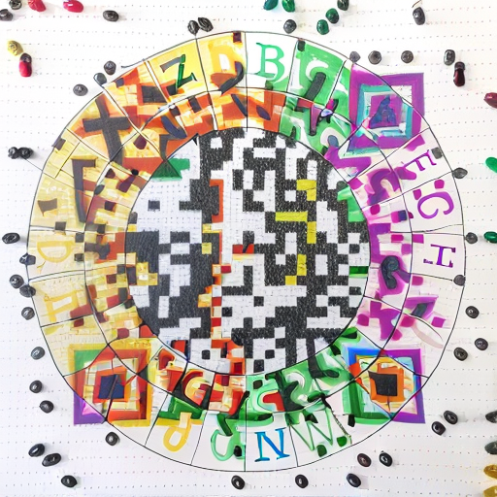
Substitution Ciphers
Caesar Cipher: this is one of the earliest known encryption methods. It involves shifting each letter of the plaintext a fixed number of positions down or up the alphabet. For example, with a shift of 3, "HELLO" becomes "KHOOR.“
https://www.dcode.fr/caesar-cipher

Slide 3
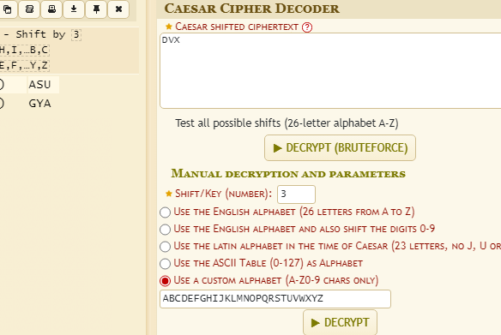
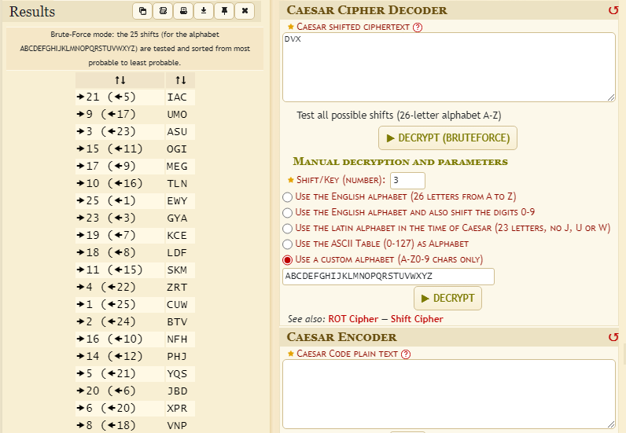
Caesar Cipher

Slide 4
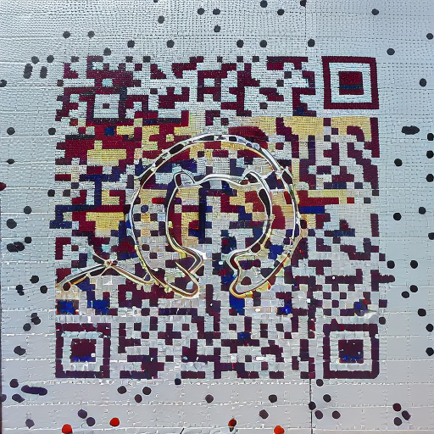
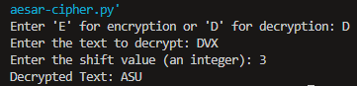
Caesar Cipher

Slide 5
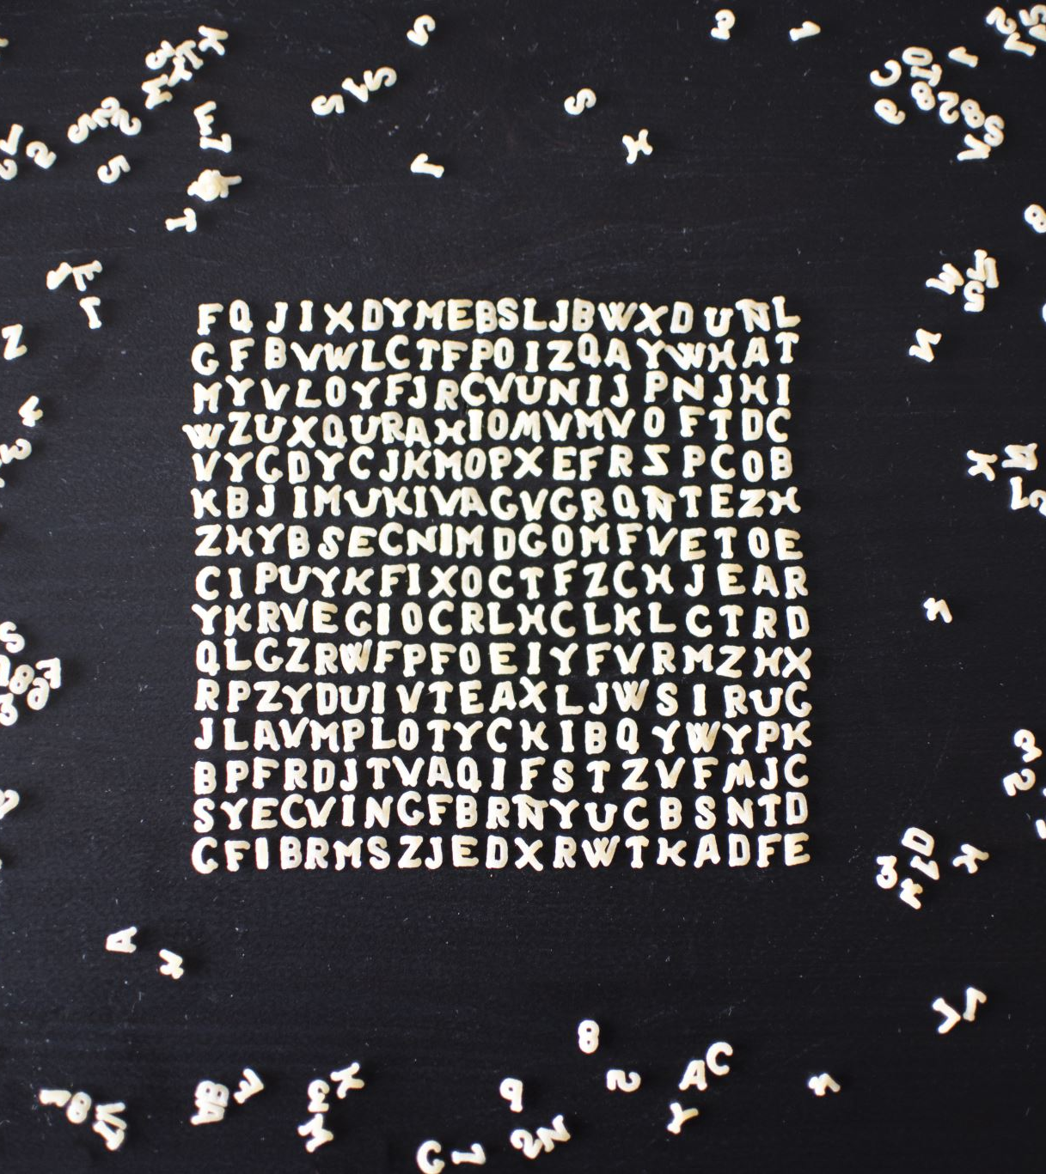
Substitution Ciphers
Atbash Cipher: It is a simple substitution cipher where each letter in the plaintext is replaced with its reverse in the alphabet. For example, 'A' becomes 'Z,' 'B' becomes 'Y,' and so on.

Slide 6
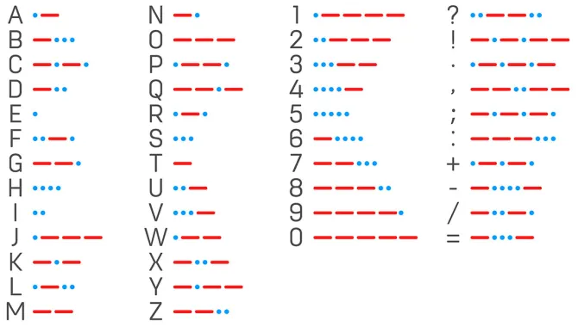

Substitution Ciphers
Morse code is a substitution cipher originally designed for telegrams, it’s alphabet consists of dots, dashes and slashes.
ASCII : ASU ASU
Morse code : .- ... ..- / .- ... ..-
http://rumkin.com/tools/cipher/morse.php

Slide 7
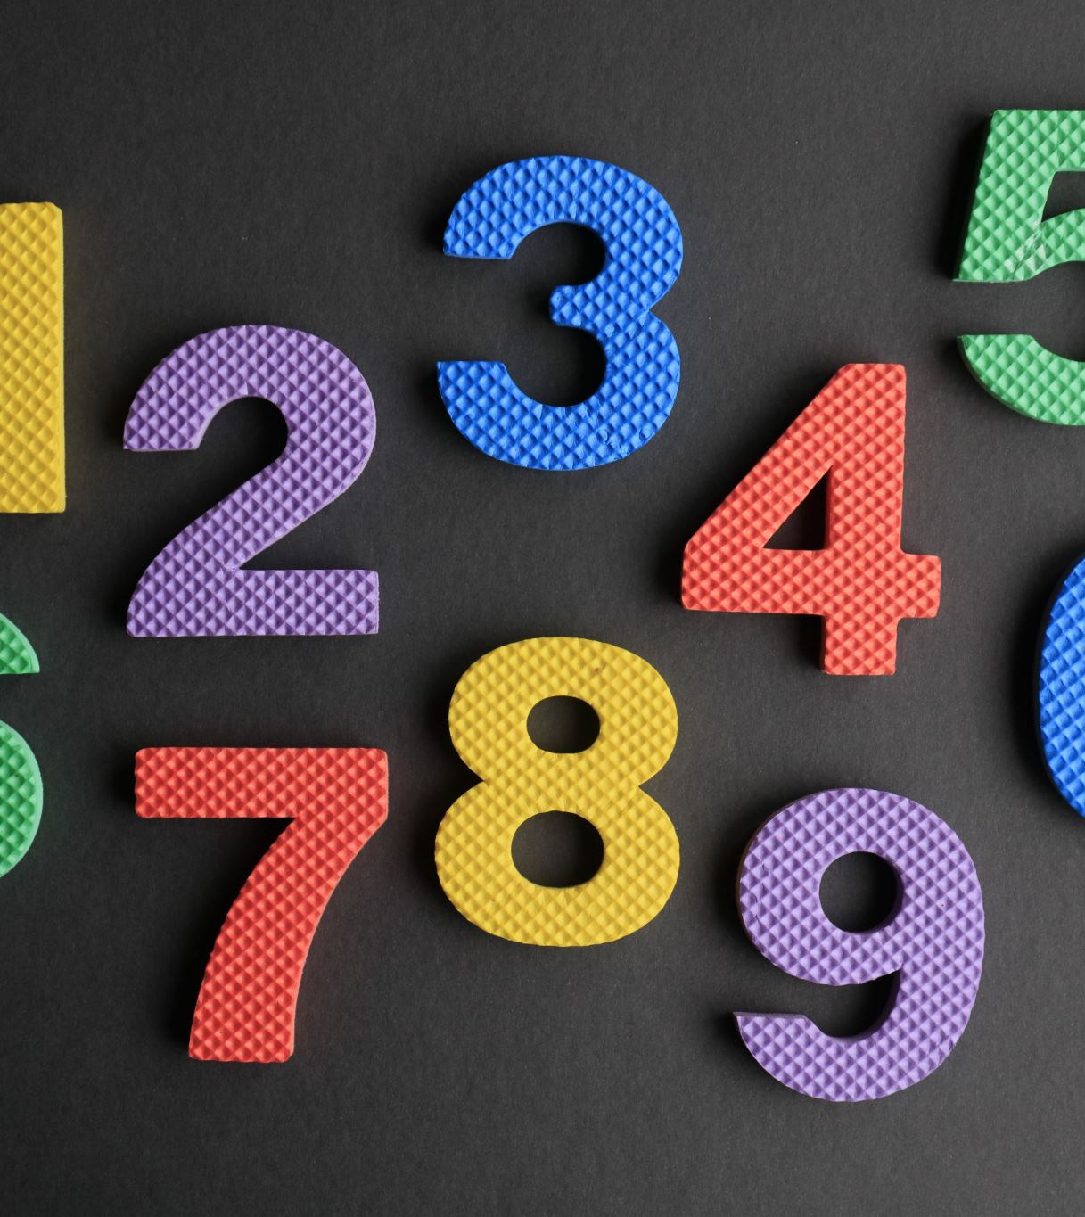
Substitution Ciphers
Letter Numbers: This substation is very straightforward:
A=1, B=2, Z=26…
ASCII : ASU
Letter Numbers : 1-19-21
http://rumkin.com/tools/cipher/numbers.php

Slide 8
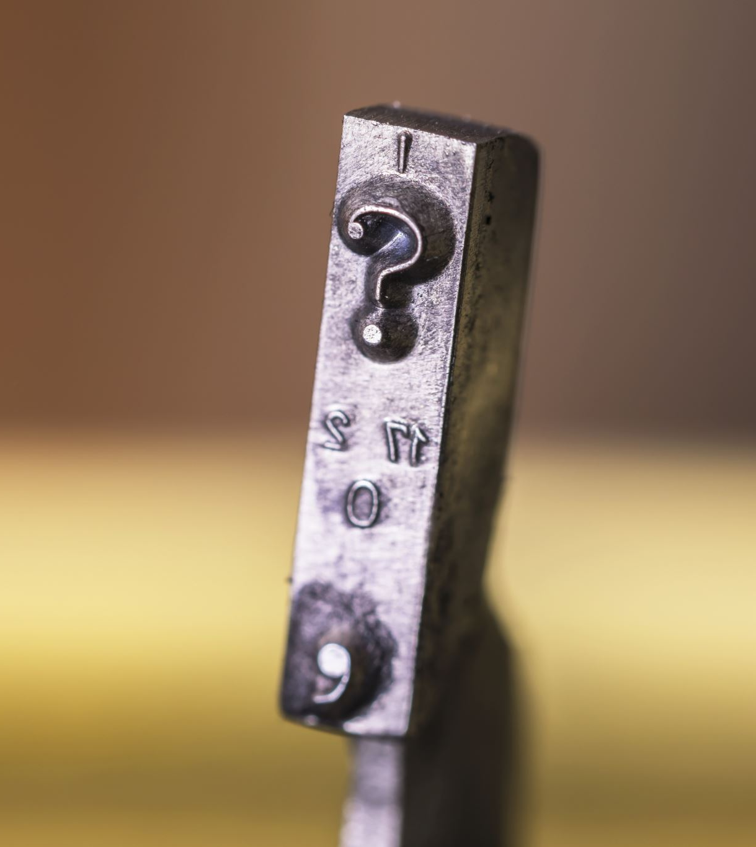
Substitution Ciphers
ROT13 is just a Caesar cipher with a key of 13. (n=13)
http://rumkin.com/tools/cipher/rot13.php

Slide 9

Substitution Ciphers
Baconian: The Baconian cipher hides a message within a message. For example, two fonts (plain and bold) could be used in a sentence. The plain letters could be the “A” form and the bold letters could be the “B” form. Ignoring the actual letters in the text and instead focusing on the different types of letters:
ASCII : ASU
Baconian : aaaaa/baaba/babaa
http://rumkin.com/tools/cipher/baconian.php

Slide 10
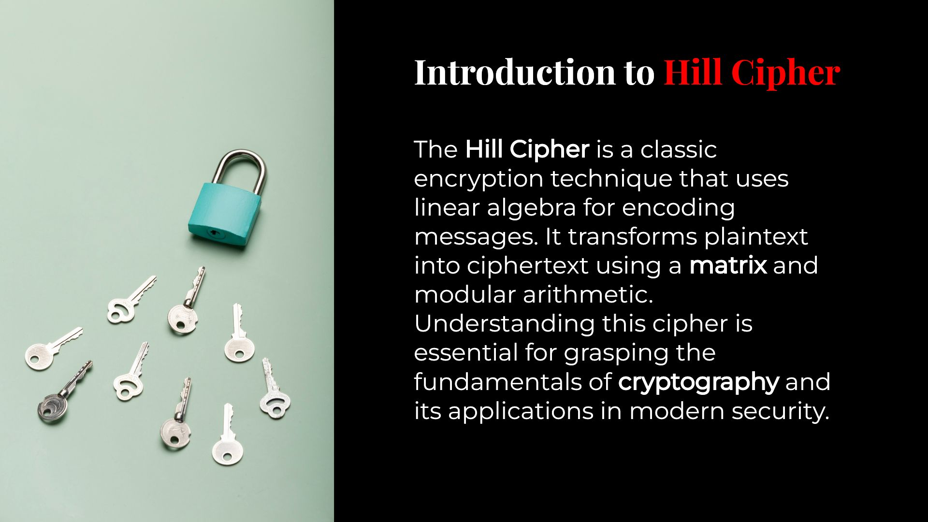

Slide 11
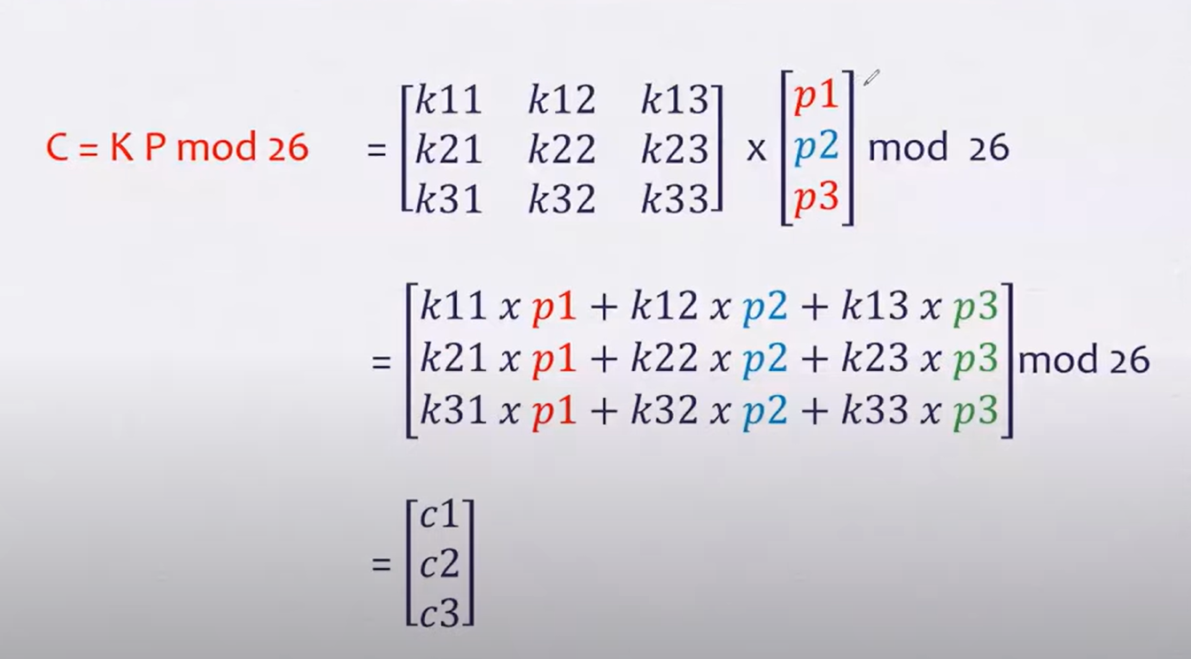

Slide 12
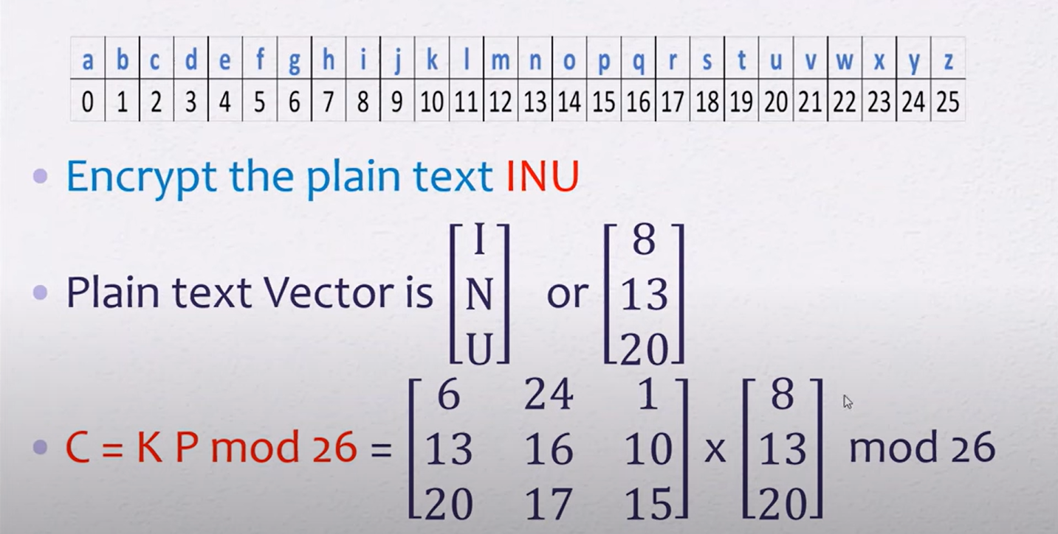

Slide 13
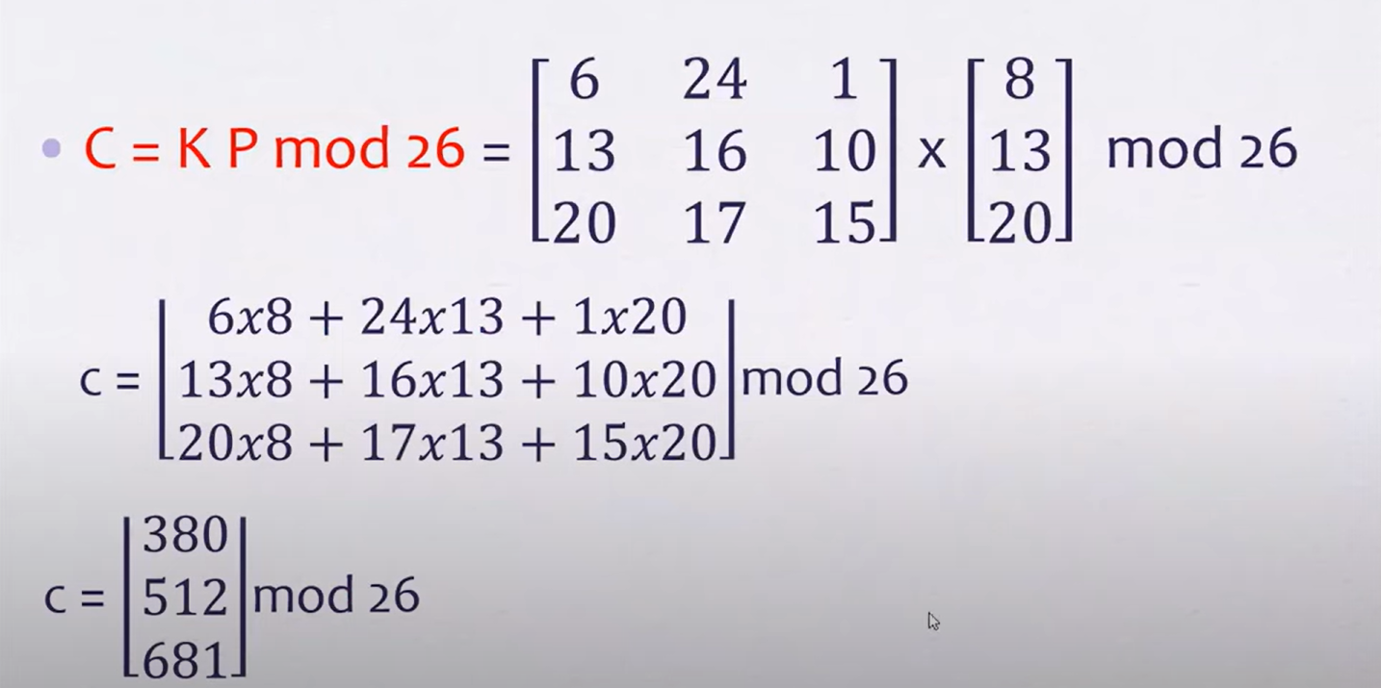

Slide 14
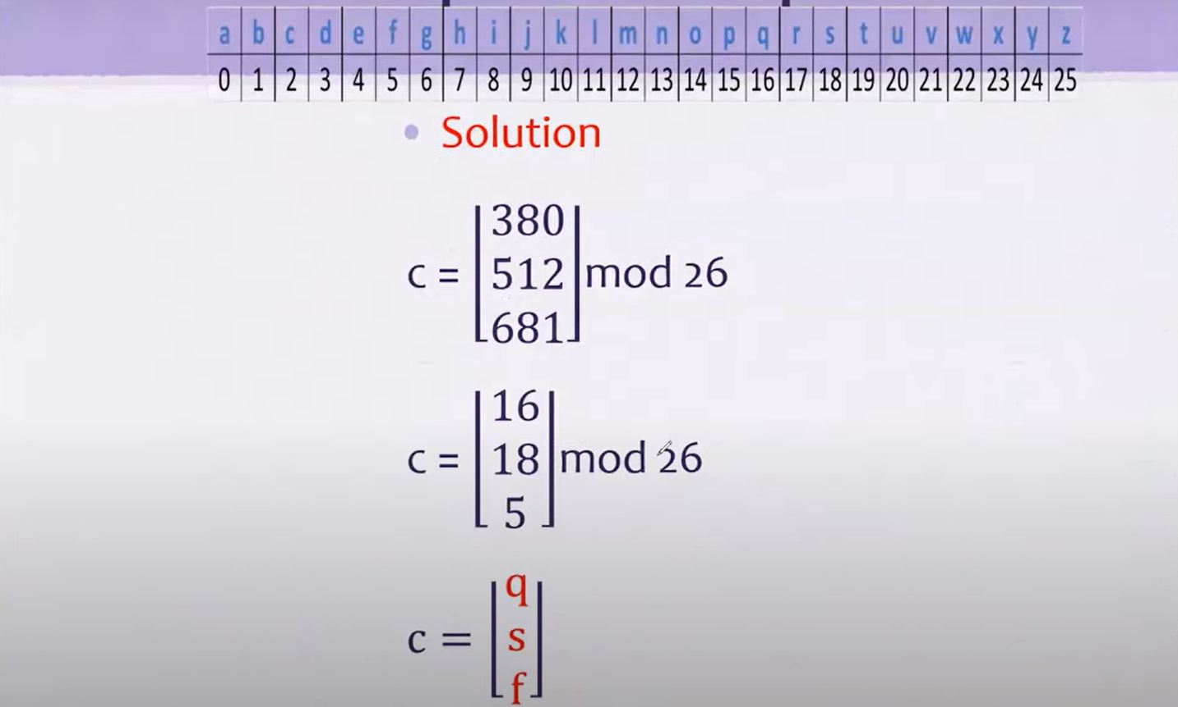

Slide 15
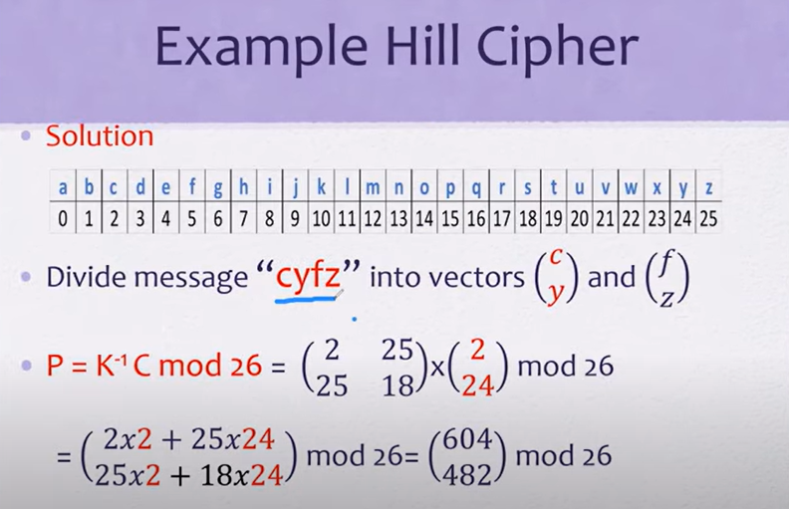

Slide 16
https://www.dcode.fr/hill-cipher

Slide 17
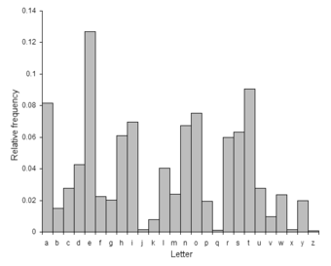
Substitution Ciphers: Vulnerable to Letter Frequency Attacks
Reason: In substitution ciphers, each plaintext letter is replaced by a specific ciphertext letter, preserving the frequencies of individual letters. For example:
The letter E (the most common in English) will still appear frequently in the ciphertext, though as a different letter.
Result: The attack exploits the direct correlation between plaintext and ciphertext frequencies.
https://alexandernwilson.com/gallery/frequency_analysis.html

Slide 18
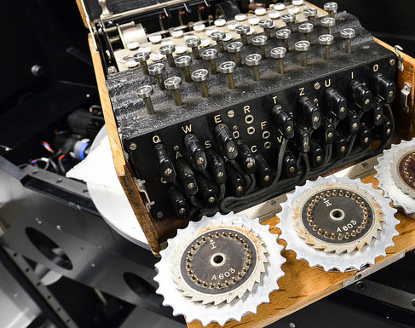
The Enigma Machine
The Enigma machine was a cryptographic device used by the German military during World War II to encrypt and decrypt secret communications. It played a significant role in the war and was a key element in the field of signals intelligence.

Slide 19
The Enigma Machine
Encryption Process: The Enigma machine operated on the principle of substitution and permutation. It used a series of rotors that could be set to different positions to scramble the input text (plaintext) into ciphertext.
Complexity: The Enigma machine was incredibly complex, with multiple settings and billions of possible encryption combinations.
Key Settings: To encrypt and decrypt messages, both the sender and receiver had to have Enigma machines with the same settings.
Codebreaking Efforts: The British codebreakers used a combination of mathematical analysis, codebreaking machines (such as the famous "Bombe"), and captured codebooks and machines to break the code.

Slide 20
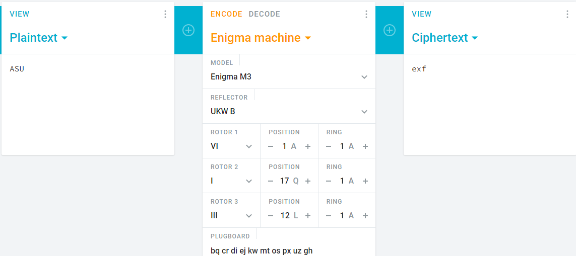
The Enigma Machine

Slide 21
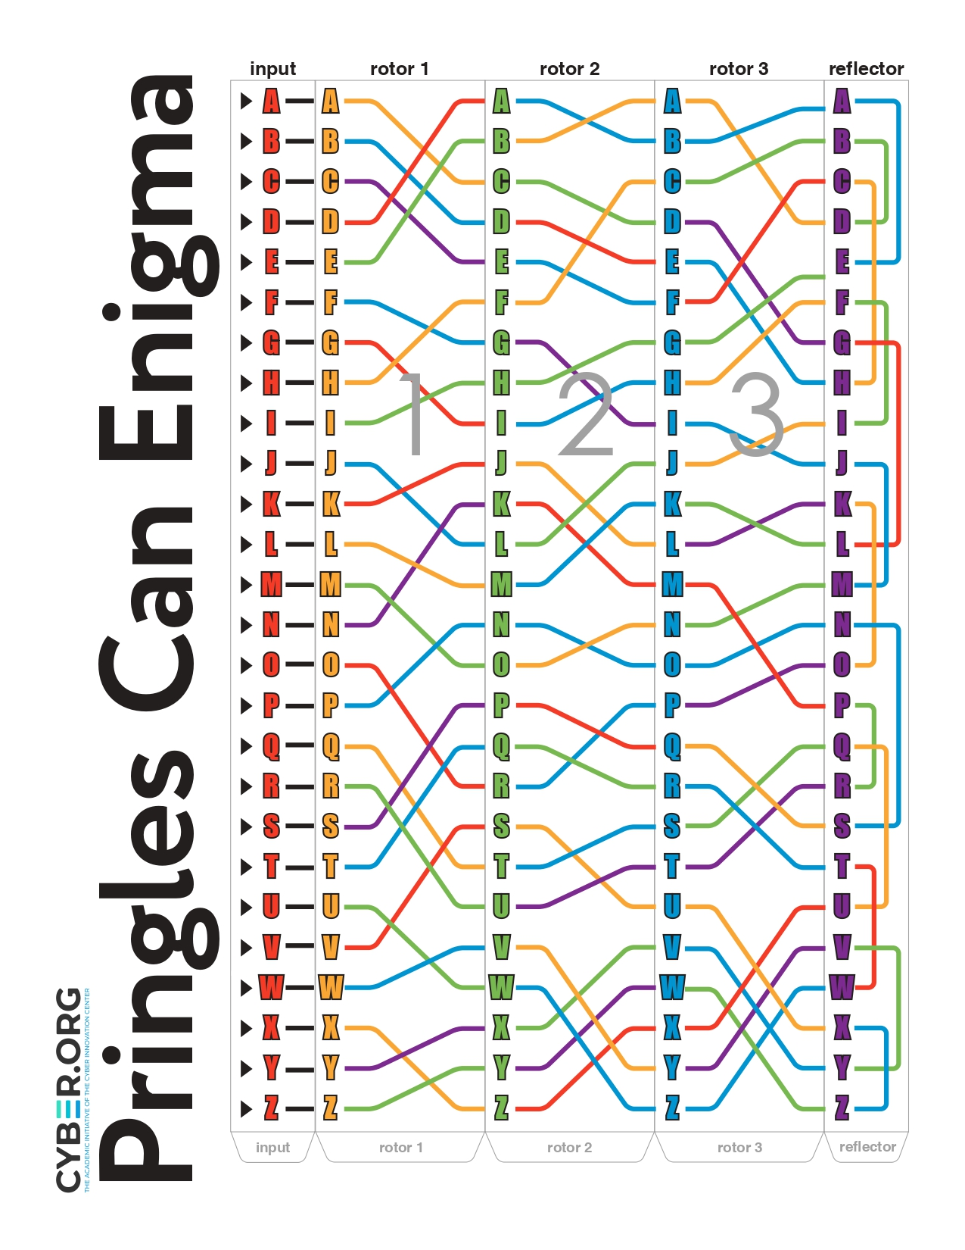
The Enigma Machine

Slide 22

The Enigma Machine
Enigma-Machine
https://www.101computing.net/enigma/

